Slide 1





DR. SHERIF GALAL
DEPI Graduation Project

Slide 2




Table of Content
1. Business Brief
2. ⁠Business Canvas
3. ⁠Situation Analysis
4. ⁠Objectives
5. ⁠Target Audience
6. ⁠Business Strategy
7. ⁠Tactics
8. ⁠Actions (Implementation Plan)
9. ⁠Control
10. ⁠Our work
11. ⁠Result Analysis
12. ⁠Recommendations

Slide 3
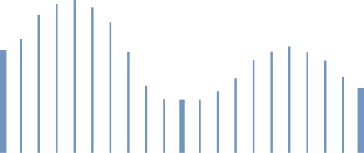


Business Brief
The project aims to build and enhance Dr. Sherif Galal’s digital presence as a cybersecurity, GRC, and BCM expert.
Transform his professional expertise into valuable and educational online content.
Establish him as a trusted voice in cybersecurity awareness within Egypt and the Arab region.
Create a consistent brand identity, content plan, and engagement strategy.
Turning expertise into education and education into influence

Slide 4




Vision | Mission | Value
Vision
Mission
Value Proposition
To make Dr. Sherif Galal a recognized cybersecurity thought leader in the Arab world, known for simplifying complex concepts and empowering others to learn.
To deliver trustworthy, simplified Arabic cybersecurity content that bridges the gap between academic theory and real-world application.
A cybersecurity expert who blends academic knowledge with executive experience, providing accessible, engaging, and practical cybersecurity education for all levels

Slide 5
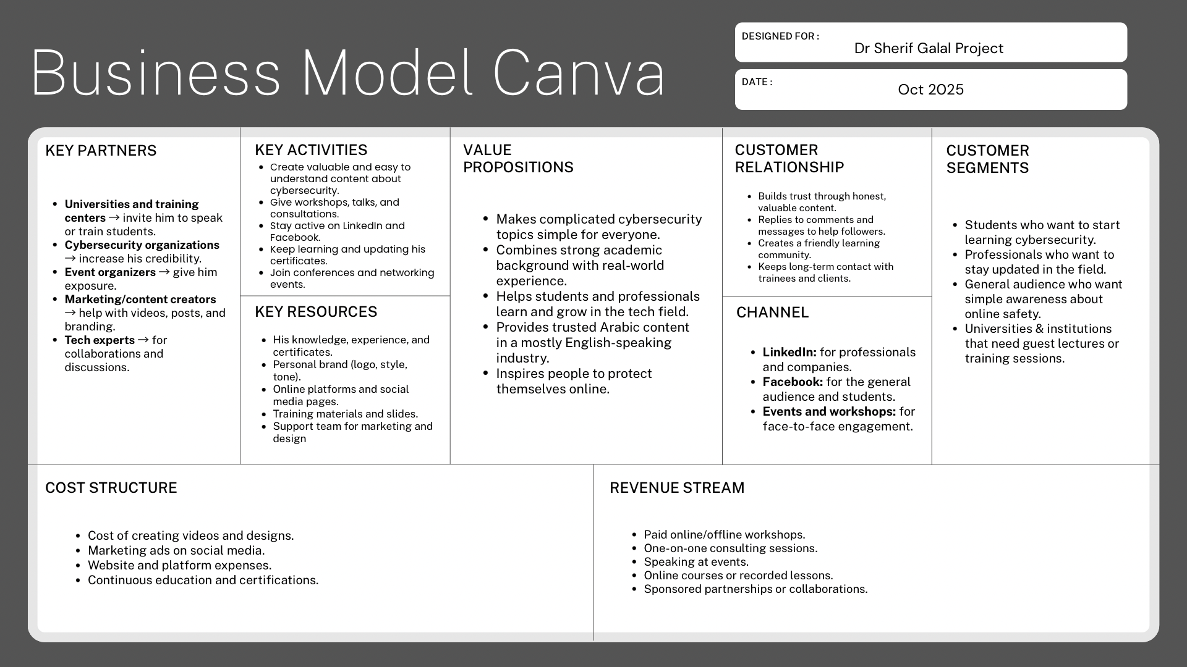
Business Model Canva

Slide 6








Key highlights
01
03
Key Partners
Key Resources
Creating educational content (videos, posts, infographics).
Delivering workshops and public talks.
Continuous learning & networking.
Deep professional expertise & certifications.
Academic background + industry experience.
Personal brand identity & digital platforms (LinkedIn, Facebook)
Simplifies complex cybersecurity concepts in Arabic.
Combines academic and real-world experience.
Builds awareness & empowers learners.
Universities.
Cybersecurity organizations.
Events.
Key Activities
Value Proposition
02
04

Slide 7

Key highlights
05
07
Customer Segments
Customer Relationship
LinkedIn: credibility & professional reach.
Facebook: broader awareness & interaction.
Workshops & events: offline engagement.
Builds trust through honest, valuable content.
Replies to comments and messages to help followers.
Creates a friendly learning community.
Revenue: Training sessions, consultations, speaking events, partnerships.
Cost: Content creation tools, paid ads, branding, and event participation
Students (learning & mentorship).
Professionals (career updates).
General audience (digital safety & awareness).
Channels
Revenue and Cost
06
08

Slide 8

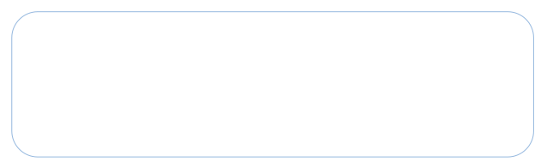






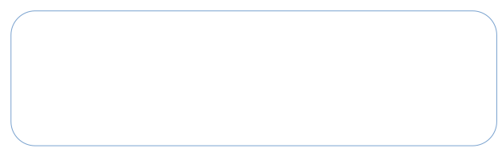




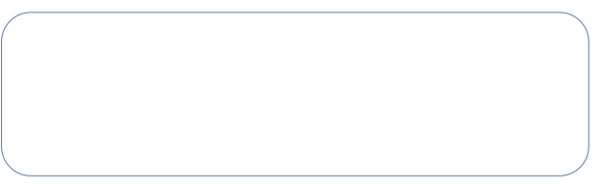
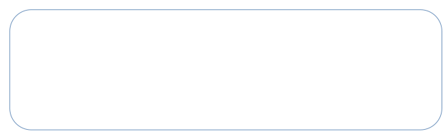





S- Situation
T- Tactics
01
04
Platforms: LinkedIn, Facebook.
Formats: posts, Videos, infographics.
Strong professional experience, but weak online presence.
O- Objective
A- Actions
Build awareness, grow audience by 15%, improve engagement.
02
05
Weekly content plan (2025-2026), task division, Consistent publishing.
SOSTAC
S- Strategy
C- Control
Focus on education, awareness, and simplicity; Arabic content.
03
06
Track KPIs (reach, engagement, followers), adjust monthly.
SOSTAC Model

Slide 9


Situation Analysis
Dr. Sherif Galal is a recognized expert in Cybersecurity, GRC, Business Continuity, Information Security, Sustainability, and Excellence standards. He has an established academic and professional presence and regularly engages in training and consulting environment
Current Situation:
Strong professional credibility through academic roles & certifications
Growing presence on LinkedIn with a knowledgeable audience
Increasing interest in cybersecurity & governance in Egypt and MENA
High demand for trusted voices & simplified education in cybersecurity

Slide 10
SWOT
Strengths
Weakness
Deep multidisciplinary expertise (GRC, BCM, Cybersecurity, ISO standards, Sustainability)
Engaging trainer & speaker
Credible academic profileExisting recognition in industry circles
Ability to simplify complex topics
Limited diversified digital content formats (Reels, carousel, long-form thought pieces)
Content publishing frequency varies
Brand identity not yet positioned as a regional authority online
Opportunities
Threats
Rapid growth of digital transformation cybersecurity mandates & Increasing awareness demand post-global cyber breaches
Growing youth & corporate interest in cyber careers & governance programs
Partnerships with universities, cyber institutions & digital media platforms
High competition from global cybersecurity educators
Misleading content from non-qualified influencers
Digital attention-span challenges- content must be engaging and simple

Slide 11
Objectives
Goal
Objective
KPIs
Increase LinkedIn followers by 15%
Reach 6% in 2 months
engagement rate average 10% in 2 months
Launch with 4 educational short videos per 2 months
Brand Visibility
Engagement
Public Awareness
Followers growth, impressions
Likes, comments, share
Video views, shares

Slide 12


Buyer Persona
Persona 1
Future Cyber Leader
Name: Omar
Profile Background: University student (IT/Business), fresh graduate, junior analyst, cybersecurity learner
Location: Egypt / MENA region
Digital Behavior: Active on LinkedIn, cyber learning platforms
Age: 20-28
Goals: Build a cybersecurity career, understand cybersecurity fundamentals
Pain Points: So many learning paths online, doesn't know where to start. Needs guidance from experts in the field

Slide 13
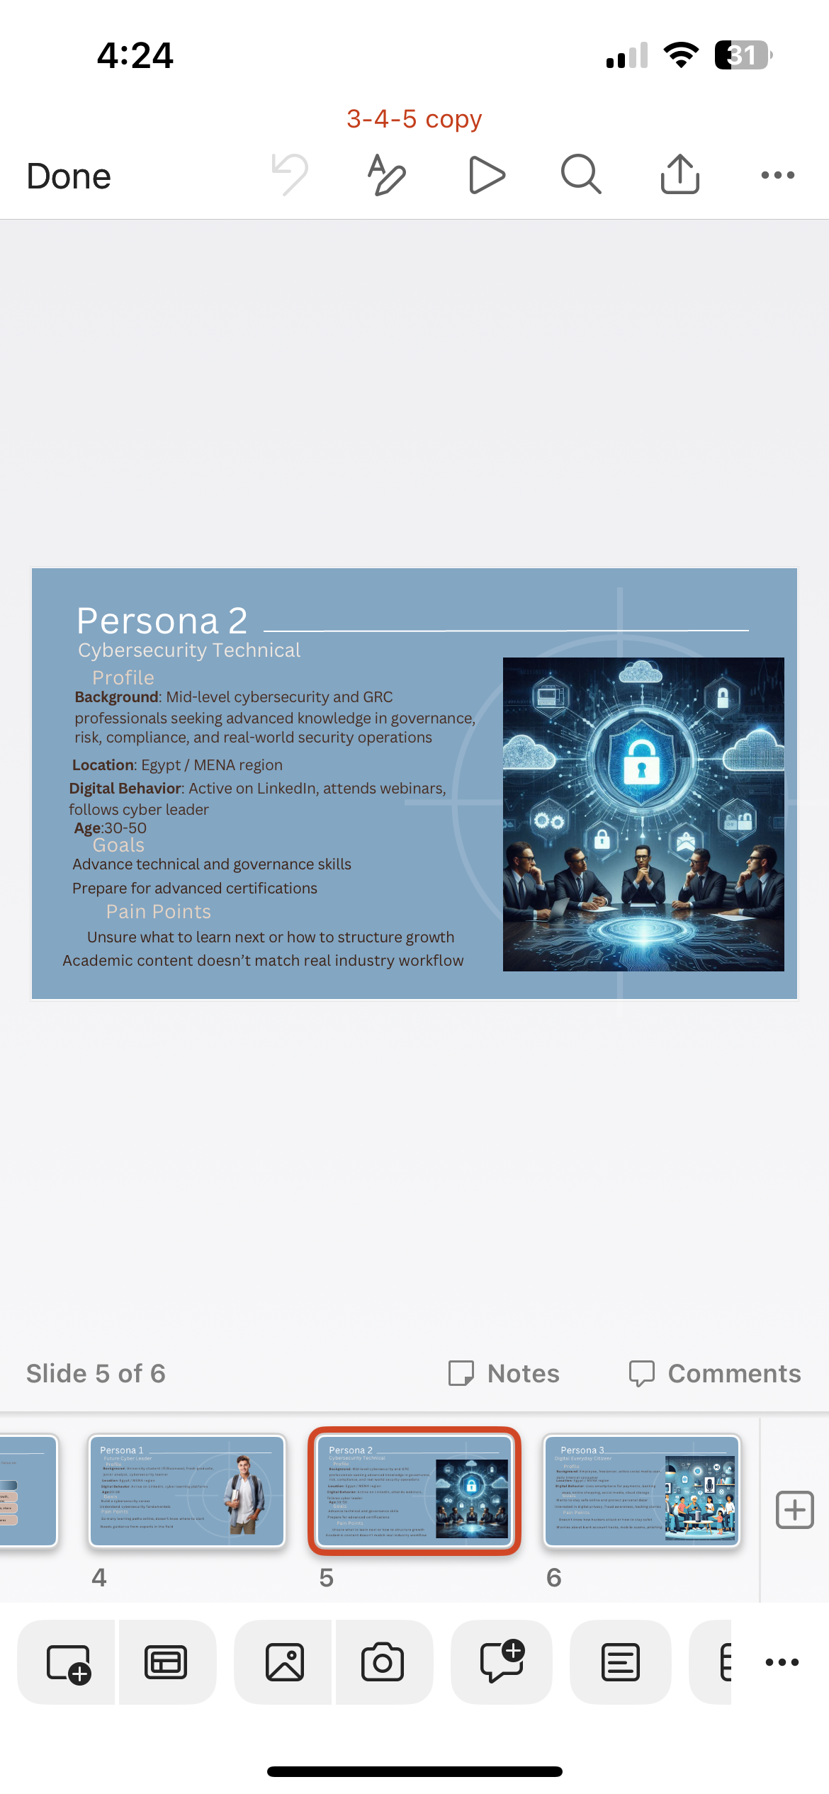
Buyer Persona
Persona 2
Cybersecurity Technical
Name: Aly
Profile Background: Mid-level cybersecurity and GRC professionals seeking advanced knowledge in governance, risk, compliance, and real-world security operations
Location: Egypt / MENA region
Digital Behavior: Active on LinkedIn, attends webinars, follows cyber leader
Age: 30-50
Goals: Advance technical and governance skillsPrepare for advanced certifications
Pain Points: Unsure what to learn next or how to structure growth, Academic content doesn't match real industry workflow

Slide 14
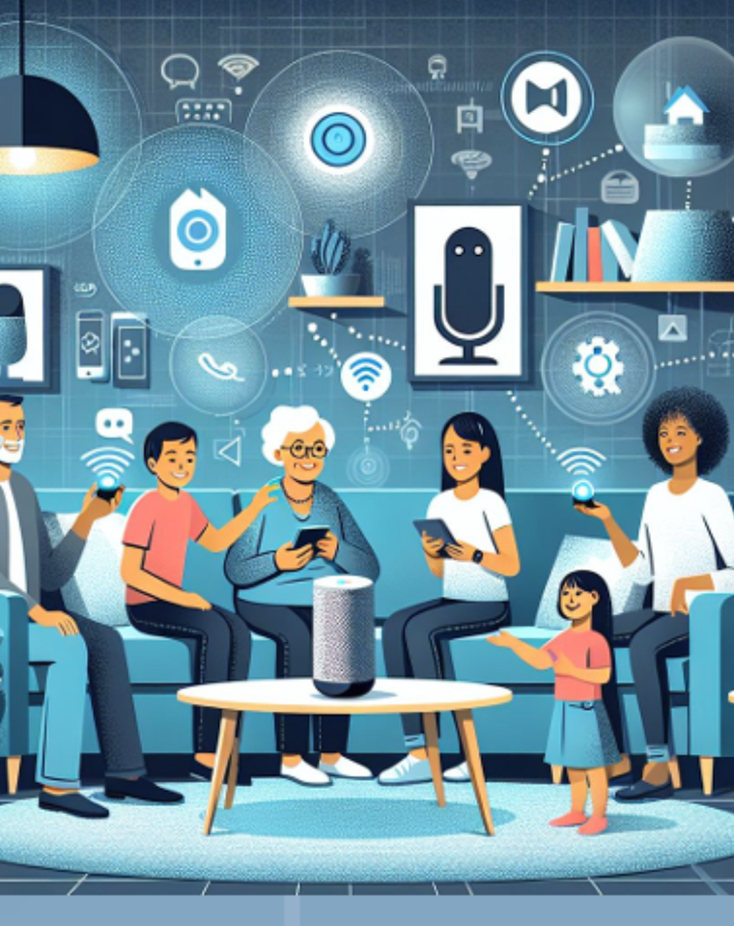
Buyer Persona
Persona 3
Digital Everyday Citizens
Profile Background: Employee, freelancer, active social media user, daily internet consumer
Location: Egypt / MENA region
Digital Behavior: Uses smartphone for payments, banking apps, online shopping, social media, cloud storage
Goals: Wants to stay safe online and protect personal data, Interested in digital privacy, fraud awareness, hacking stories
Pain Points: Doesn't know how hackers attack or how to stay safe, Worries about bank account hacks, mobile scams, phishing

Slide 15
Business Strategy
01
Brand positioning
02
Tone of Voice
03
Key Messaging
04
Content Pillars

Slide 16

4 Ps
Product
Price
Educational cybersecurity content.
Simplified Arabic explanations.
Infographics, reels, carousels, awareness tips.
Practical insights from real experience.
Free educational content.
Paid services in the future:
Trainings & workshops
Consulting sessions
Speaking engagements
Place
Promotion
LinkedIn: main platform for authority and professional audience.
Facebook: wider reach and general audience.
Events, webinars, and workshops for offline presence.
Reels, carousels, storytelling posts.
Consistent posting (3× per week).
Hashtags & visual branding.
Interactive tools: polls, Q&A, engagement posts.

Slide 17

Brand Positioning
“Educational. Professional. Trust-Based.”
Position Dr. Sherif Galal as a trusted Arabic cybersecurity and GRC thought leader who simplifies complex concepts into actionable, human-centered insights.
He stands at the intersection of academic credibility and practical industry experience, turning expertise into influence through authentic educational storytelling.

Slide 18
Tone of Voice
Educational
Trustworthy
Informs and teaches in Arabic.
Example:
“في وقت الهجوم السيبراني، أول 10 دقايق أهم من أي حاجة تانية..’’
Expert, fact-based tone with real-world context
Example:
‘”أنا د. شريف جلال على مدار مسيرتي المهنية، التي امتدت أكثر من 25 عام من الأدوار التقنية إلى المناصب القيادية والان كرئيس تنفيذي للعمليات (COO) ورئيس لقطاع الحوكمة والمخاطر والالتزام..’’
Empowering
Approachable
Encourages continuous learning and curiosity
Example:
‘’هنتكلم فيها بطريقة بسيطة عن إزاي تحمي نفسك ومؤسستك من أي مخاطر رقمية، من أول خطوات صغيرة زي الباسورد لحد مفاهيم أعمق زي إدارة المخاطر’’
Friendly and inclusive
Example:
‘’الأمن السيبراني مش حاجة تخص المتخصصين بس،
ده ببساطة الطريقة اللي بنحمي بيها نفسنا وبياناتنا من السرقة أو الاختراق.‘‘

Slide 19
Key Messaging
“Cybersecurity is for everyone — knowledge is the best defense.”
“From academic insight to real-world protection.”
“Learning cyber in Arabic — clear, simple, and practical.”

Slide 20

Content Pillars
Education
Awareness
Core 70%
Simplifying complex cybersecurity and GRC topics in Arabic to educate professionals, students, and the general public.
15%
Timely content around cyber trends, digital safety, and incident responses.
Posts during Cybersecurity Awareness Month.
Posts about how to protect yourself online
Brand Visibility
Engagement
Public Awareness

Slide 21
Content Pillars
Personal Branding
Engagement
10%
Behind-the-scenes insights from teaching, speaking, and consulting.
Certifications, media mentions, or collaborations that strengthen credibility.
5%
Light, story-based posts that humanize cybersecurity concepts.
Brand Visibility
Engagement
Public Awareness

Slide 22
Tactics
01
LinkedIn
02
Facebook
03
Workshop/Events

Slide 23
Channel Strategy
Platform | Purpose | Content Type
LinkedIn | Build authority & reach professionals | Educational posts, workshop recaps
Facebook | Broader awareness & public engagement | Educational posts, workshop recaps
Workshops/Events | Offline credibility | Participation in global conferences, keynote reflections, cybersecurity panels

Slide 24
Action
Area | Objective | Status | When | Who | Platform
Event coverage & highlights | Post updates and visuals from attended events and certificates to increase credibility. | Strong engagement and reach improvement. | During Events | Salma | Facebook & LinkedIn
Content creation | Create and publish awareness, educational, and professional posts using clear and understandable language to engage the audience effectively. | Consistent posting and audience growth maintained. | Monthly | Nehal | Facebook & LinkedIn

Slide 25
Visuals & AI tools | Use AI and editing tools to select, organize, and enhance visuals for posts to improve clarity and audience engagement. | Better visual appeal and interaction achieved. | Weekly | Gehad | Facebook & LinkedIn
Performance monitoring | Track insights and metrics to optimize future content strategies. | Continuous improvement in engagement metrics. | Monthly | Hagar | Facebook & LinkedIn
Community management | Engage with followers by replying to comments and messages to maintain active communication and support audience interaction. | Boosted interaction and follower connection. | Ongoing | Asmaa | Facebook & LinkedIn
Noting that there was weekly rotations between the team members
For more click here

Slide 26
Control
Platform | Metrics Tracked | Tools | Frequency | Target | Insights & Key findings
Facebook | Reach & Engagement | Facebook insights | Weekly | Improve engagement and page growth | Event & awareness posts had the highest engagement
LinkedIn | Impressions, Engagement rate | LinkedIn analysis | Weekly | Increase visibility and followers | Professional tone and visuals improved visibility
Content Review | Post type, timing, topic | Manual tracking | Monthly | Maintain steady growth | Educational posts generated consistent and positive interactions
Overall Evaluation | Overall social media performanc, followers growth | Manual observation | Monthly | Sustain engagement rate | Continuous growth in audience engagement
For more click here

Slide 27
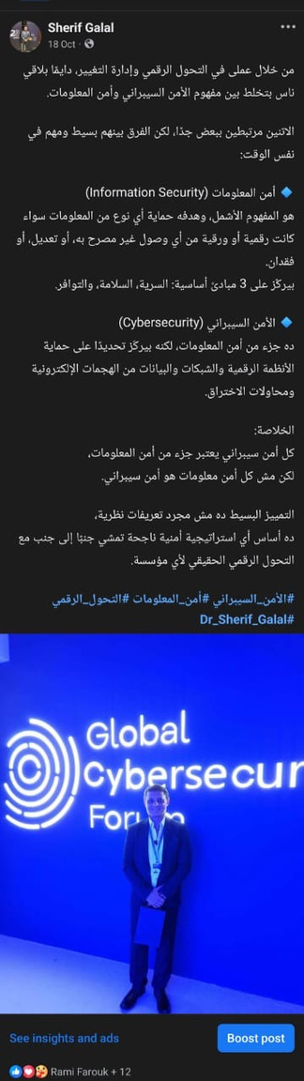
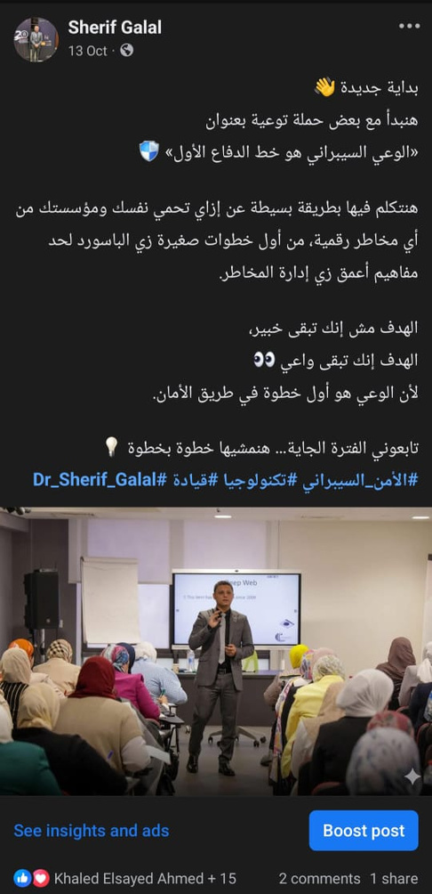
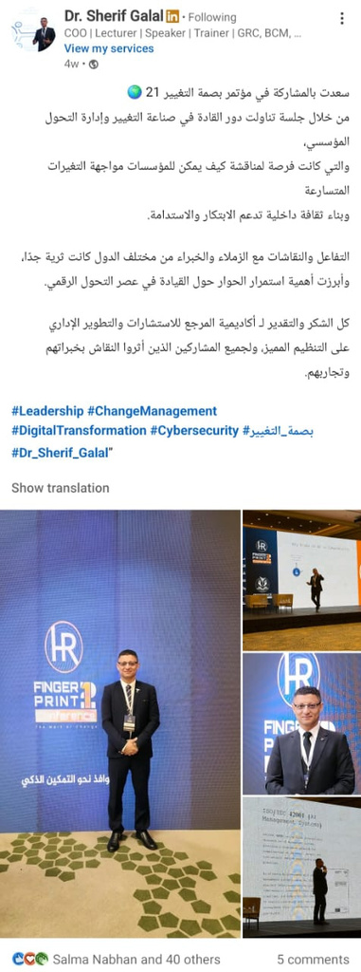
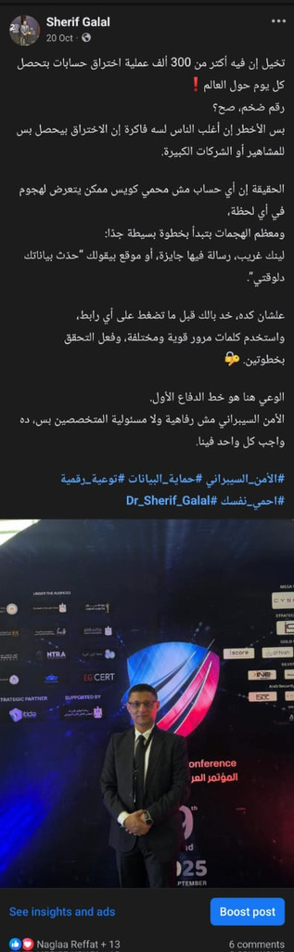
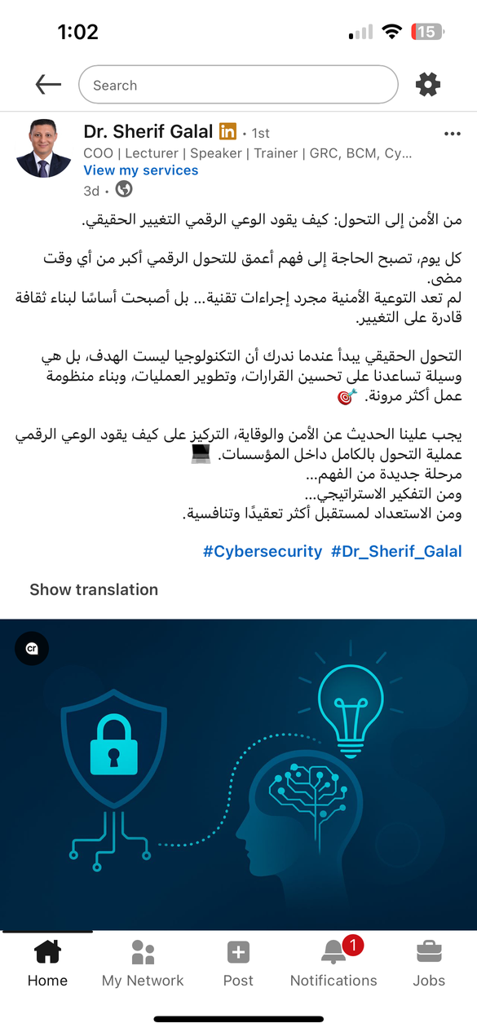
Our Work

Slide 28
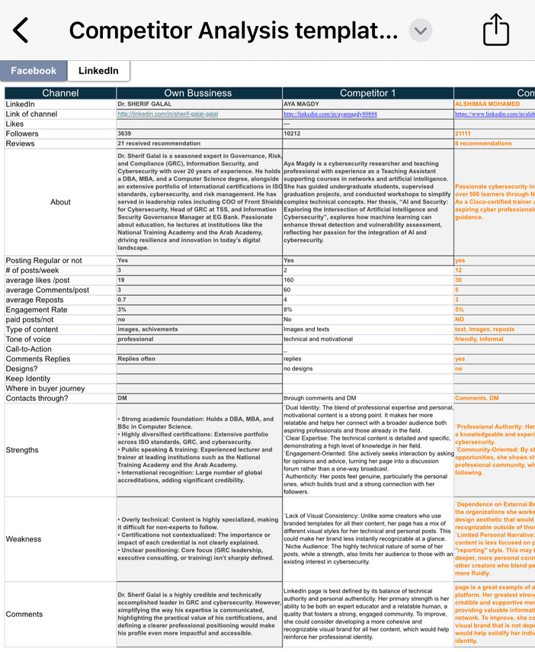
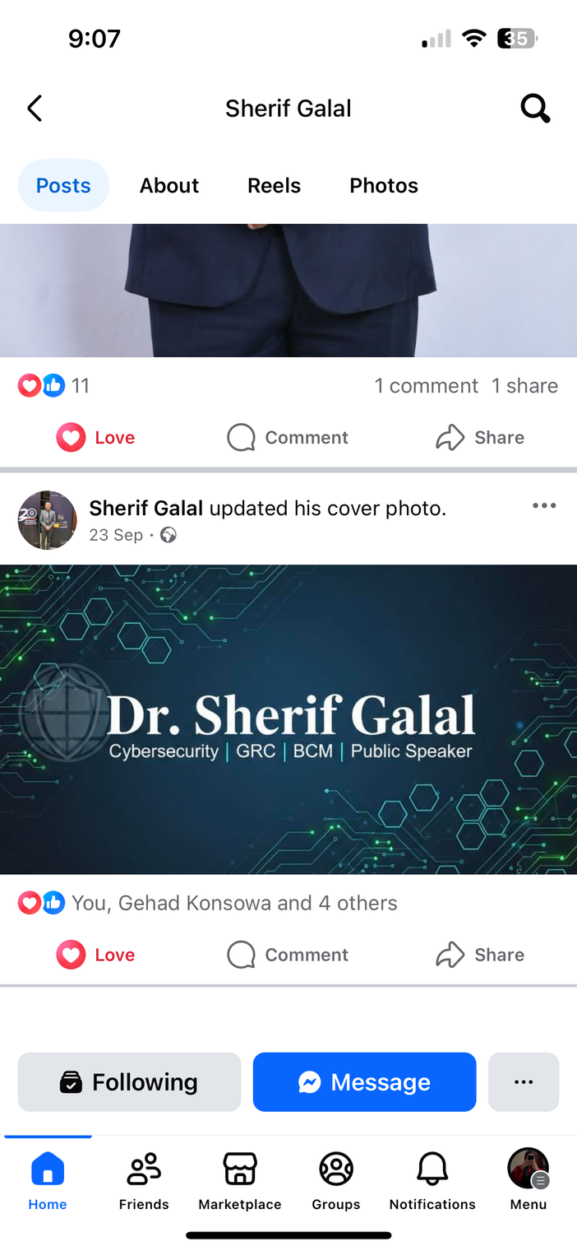
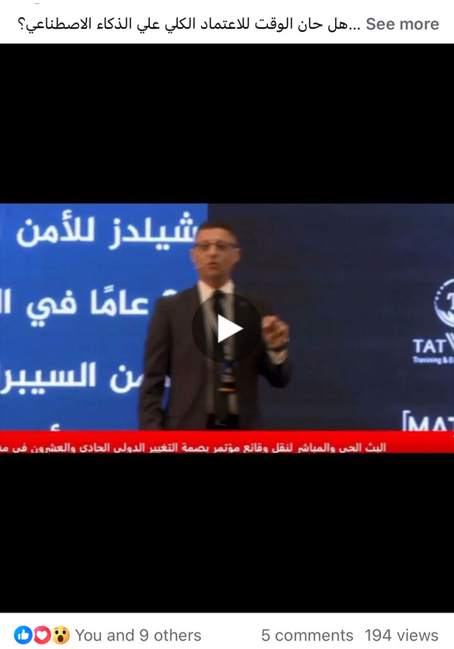
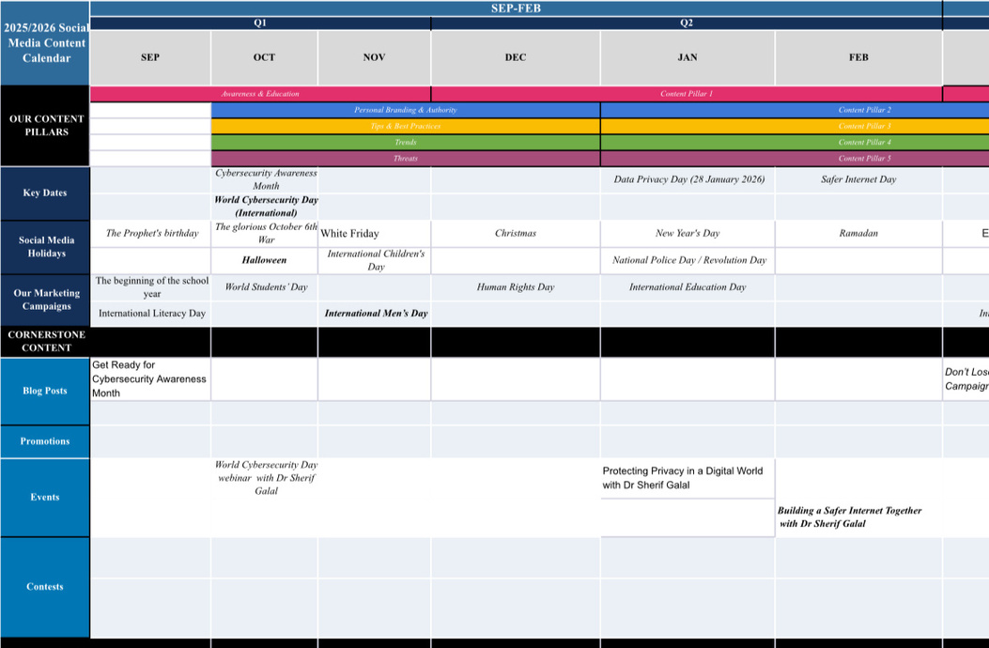
Our Work

Slide 29
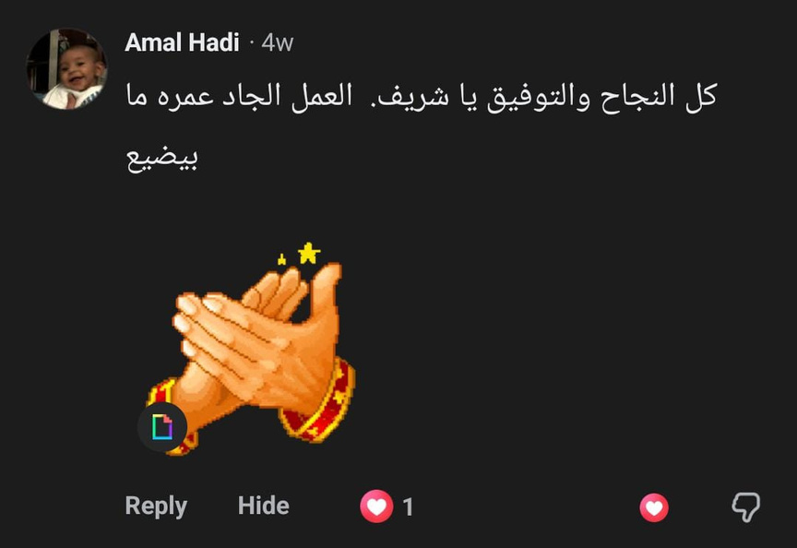
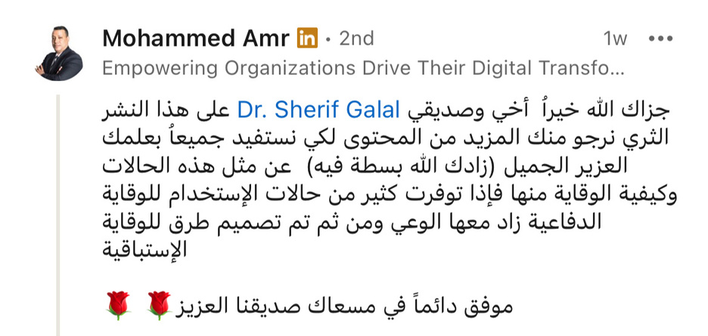
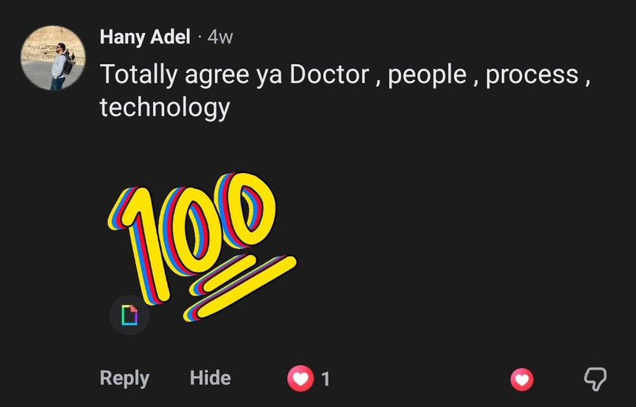
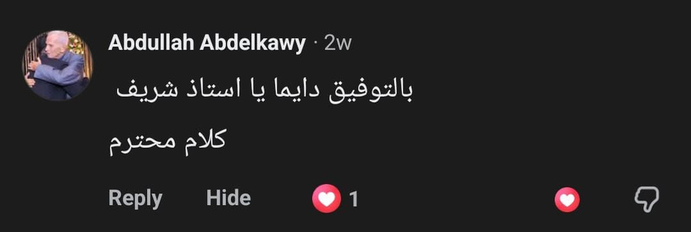
Opinions

Slide 30
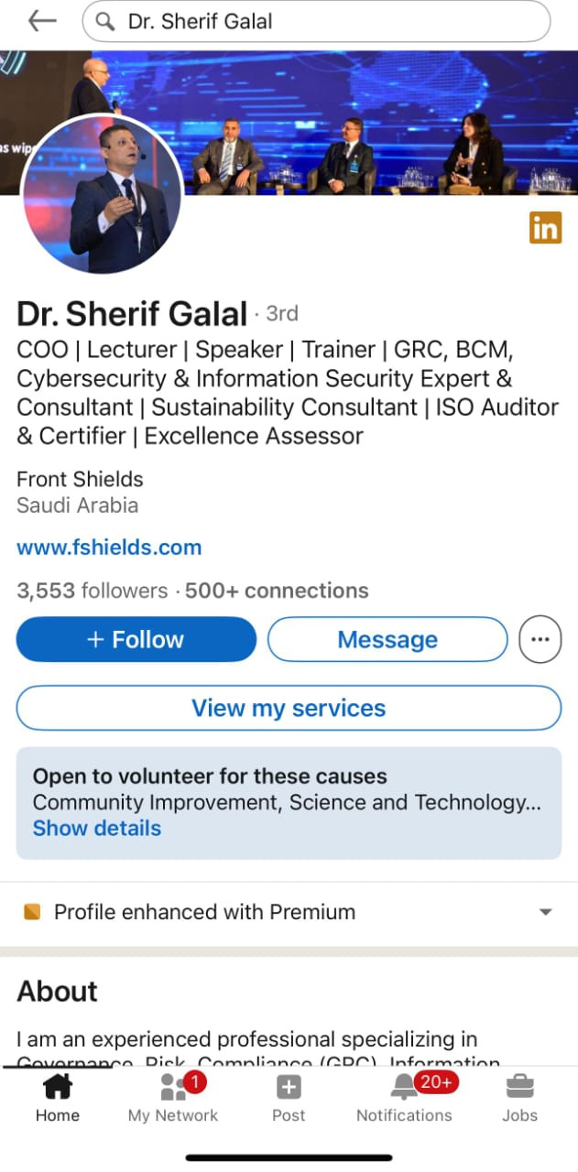
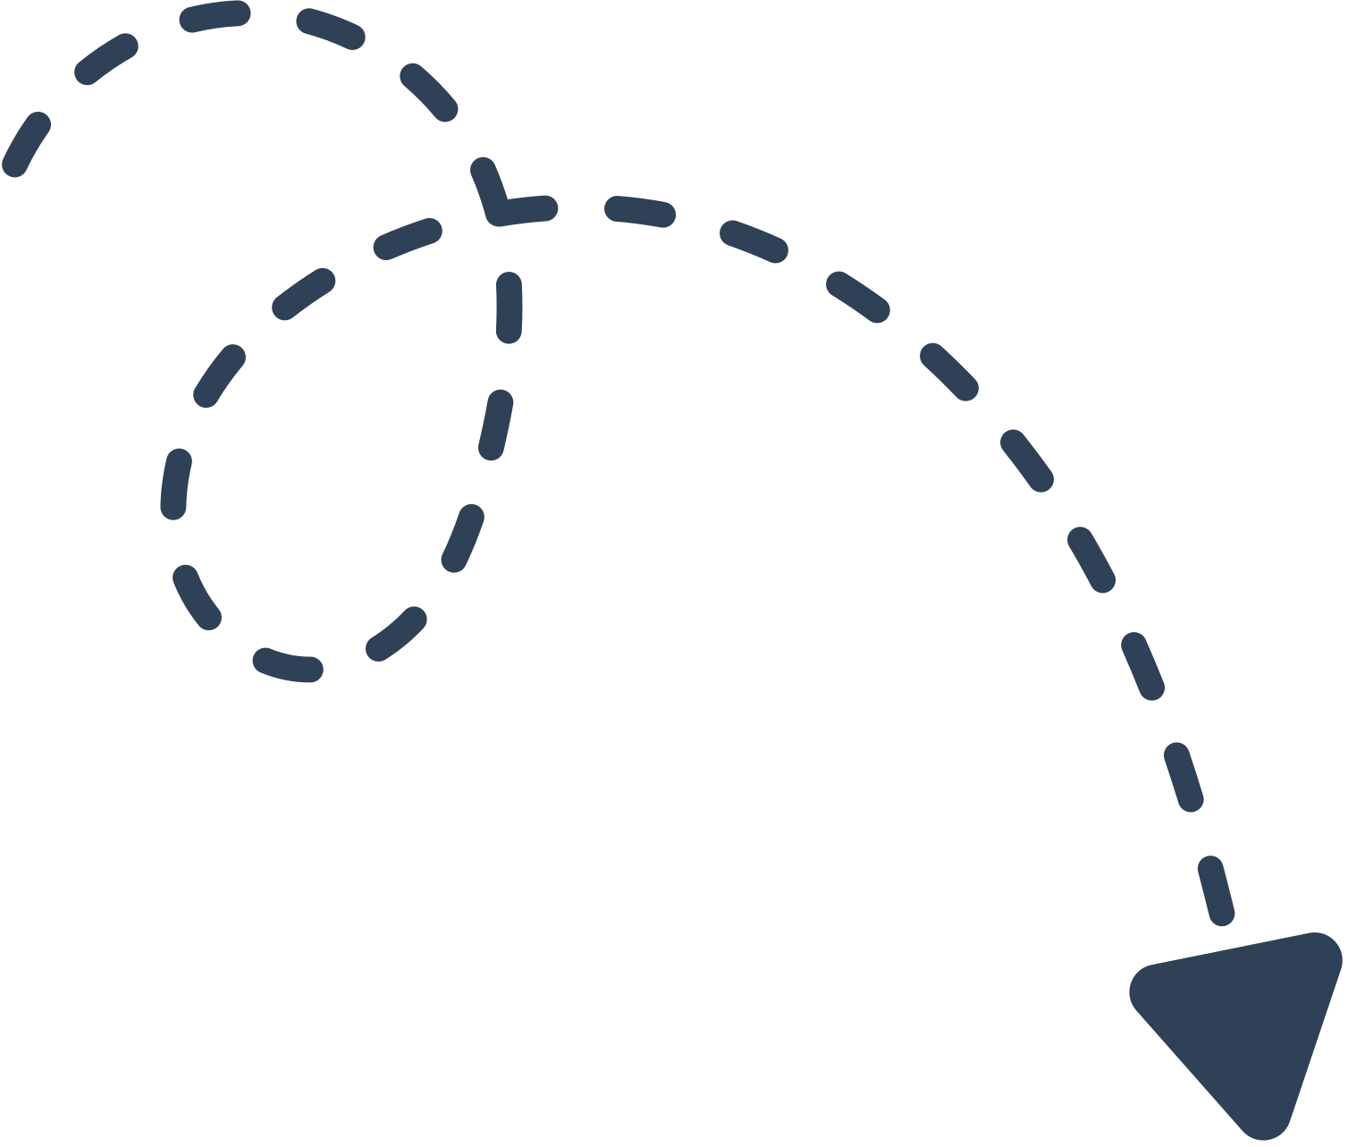
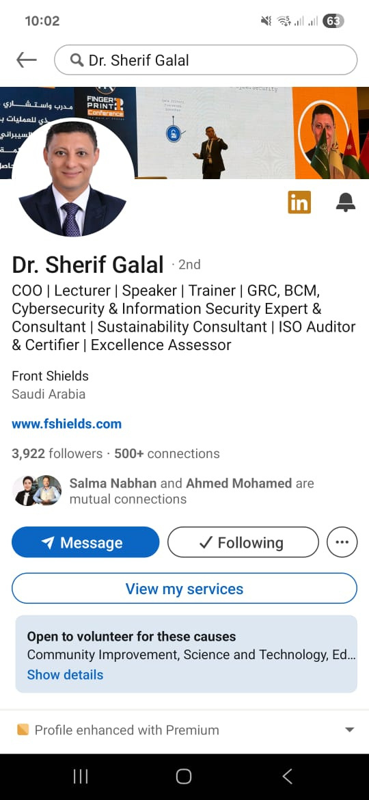
Result Analysis
Growth and Analysis
Significant increase in followers (10.38%) from 3,553 to 3,922, boosting brand awareness and reach, especially on LinkedIn and Facebook.

Slide 31
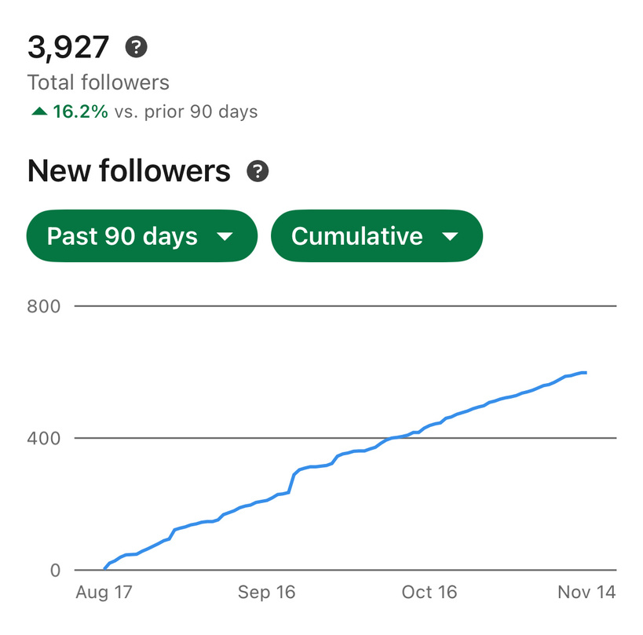
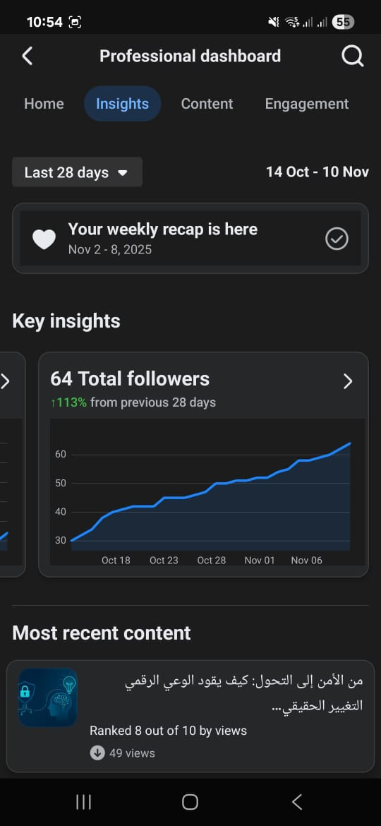
Growth and Analysis
Facebook
LinkedIn

Slide 32
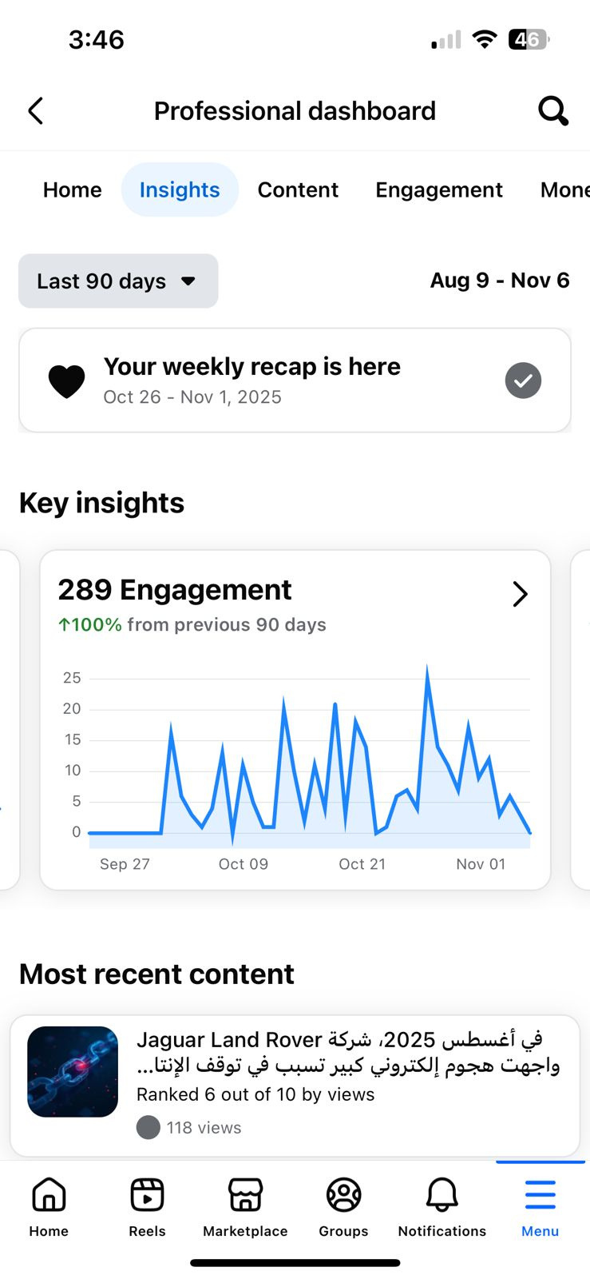
Result Analysis
Engagement
Engagement rate improved steadily, with Reels and posts driving the best interaction. Educational content received strong audience response.

Slide 33
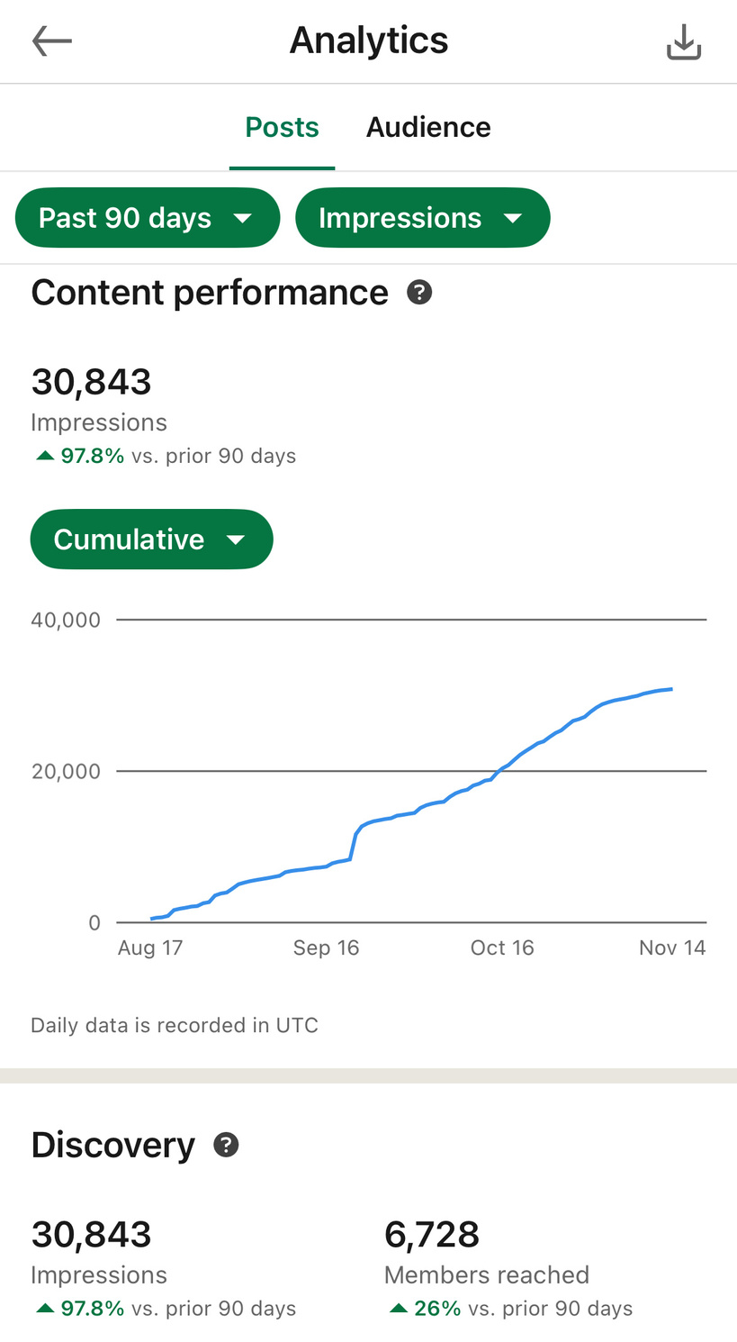
Result Analysis
Content Performance
Educational Arabic posts and cybersecurity topics generated the highest saves and shares. Short, visual content delivered superior reach.

Slide 34
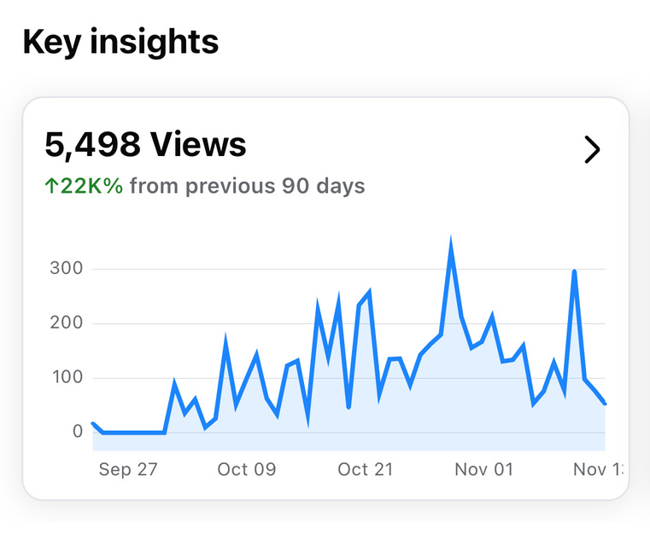
Result Analysis
Brand Image
Profile credibility increased; content clearly reflects Dr. Sherif's expertise and teaching style, highlighted by positive audience feedback on clarity and trustworthiness.

Slide 35
Recommendations
Content Production & Efficiency
Outsource Drafting: Utilize a specialist writer for content drafts, allowing Dr. Sherif to focus on final review and quality.
Prioritize Video: Focus heavily on creating short videos and tutorials to simplify complex topics and boost engagement.
Targeted Focus: Continue high-performing Arabic educational content.

Slide 36
Recommendations
Engagement & Community
Increase Webinars: Host more live webinars, separating them for specialists and youth audiences.
Direct Interaction: Use Q&As and Lives for direct engagement, and build an email/group channel for direct communication.
Performance & Growth
Address Organic Reach: Allocate budget for Paid Ads (boosting) to compensate for weak organic reach and achieve faster audience growth.
Data-Driven: Review analytics monthly to adjust topics and content formats accordingly.

Slide 37
Recommendations
Platforms & Branding
Expand Reach: Launch a YouTube channel for long-form content and explore younger platforms.
Maintain Professionalism: Ensure consistent posting (3 times/week) and apply a unified visual identity across all channels.

Slide 38

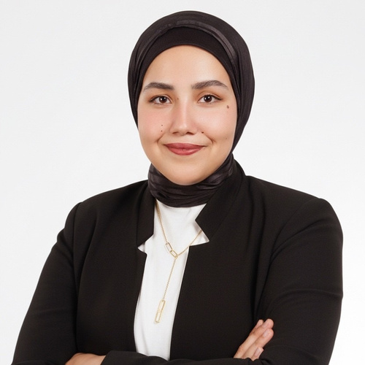
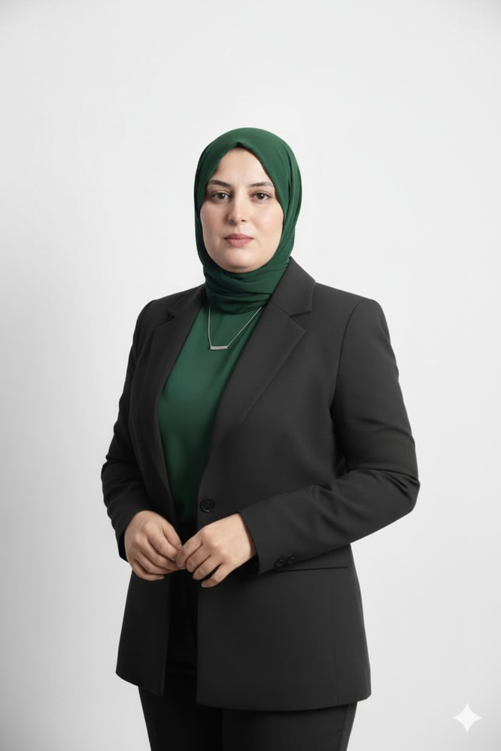

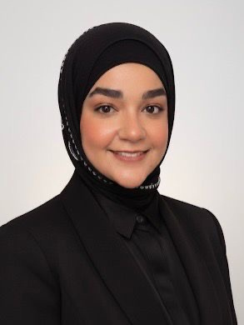
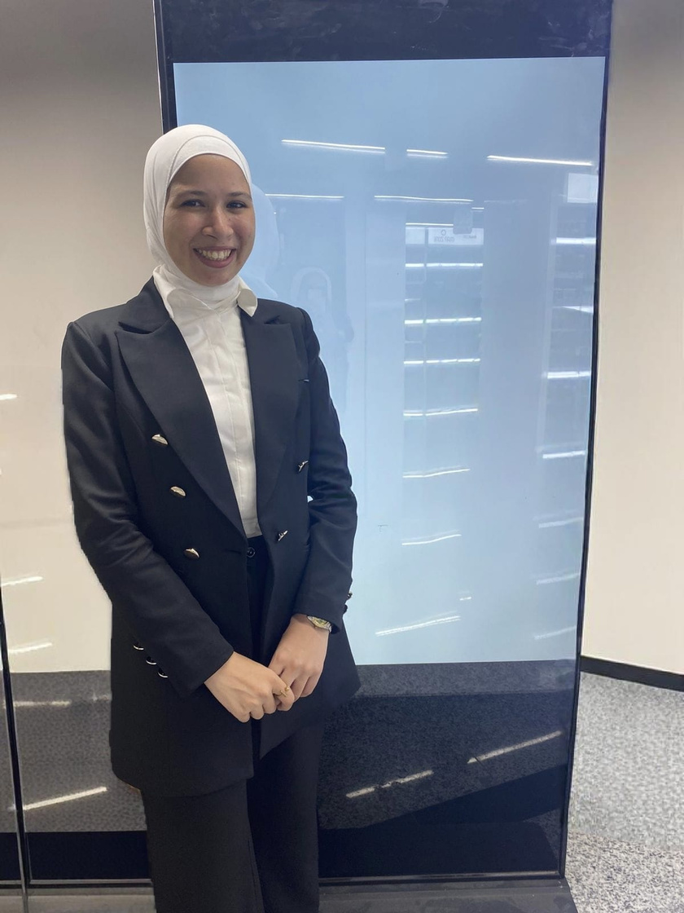
Our Team
Salma Nabhan
Team Leader
Asmaa Mahfouz
Hagar Tareq
Nehal Adel
Gehad Konsowa
A multidisciplinary team working hand-in-hand to turn ideas into impactful outcomes

Slide 39
THANK YOU!

